Slide 1



Frontend Web Development Internship
5-Week Internship Training & Project Presentation
ABHAY PRATAP SINGH
B.TECH – CS / DATA SCIENCE
CS-23411052
IILM UNIVERSITY
GREATER NOIDA

Slide 2
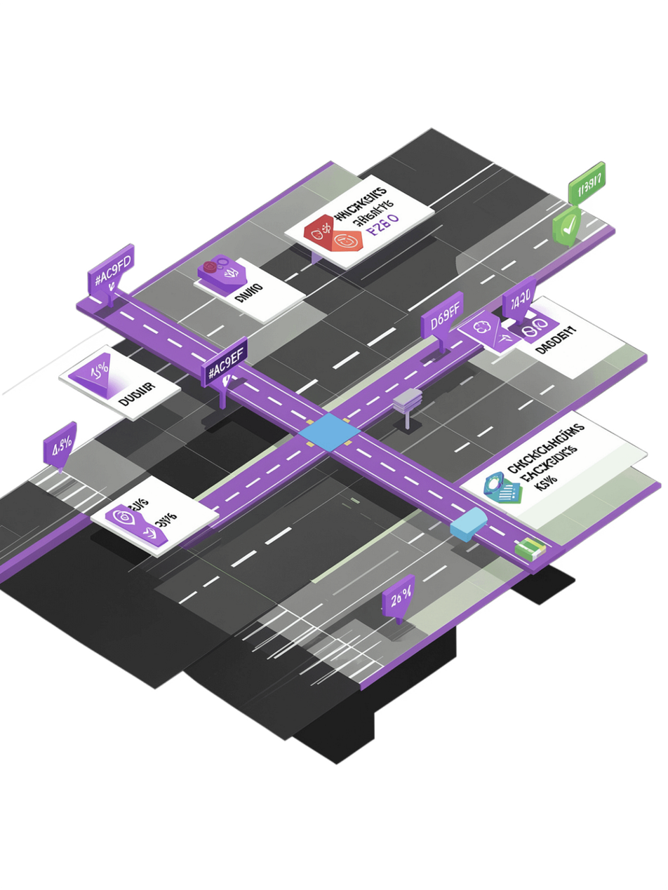




Internship Overview
Learning Path
Focus Areas
  Static webpage development with semantic HTML
  Responsive web design with Flexbox & CSS Grid
  JavaScript interactivity & DOM manipulation
  Performance optimization & accessibility
  Single Page Application architecture
HTML
CSS
JavaScript
SPA

Slide 3




Technologies & Tools Used
HTML5
CSS3
Semantic markup & structure
Flexbox, Grid, Media Queries
JavaScript
Dev Tools
DOM, Events, Local Storage, History API
VS Code, Chrome DevTools, Lighthouse, Git/GitHub

Slide 4
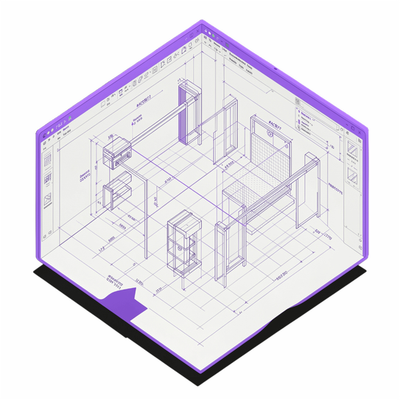

Weeks 1–2: Static & Responsive Web Development
Week 1 — Wireframe to Static Webpage
  Analyzed wireframe and design specifications
  Created semantic HTML structure
  Recreated layout using CSS Flexbox & Grid
  Organized HTML/CSS for maintainability
Week 2 — Responsive Web Design
  Flexible grids & CSS media queries for breakpoints
  Responsive units: rem, em, %
  Adapted typography, spacing, nav & cards
  Tested across desktop, tablet & mobile
Wireframe
Static Site
Responsive Site

Slide 5


Week 3: JavaScript Interactivity
Interactive Features Implemented
DOM & Events
Dynamic content rendering & event listeners
User Action
Forms & Nav
JS Event
Real-time form validation & mobile menu
DOM Manipulation
Theme Toggle
UI Update
Light/Dark mode with Local Storage persistence
Animations
Smooth UI transitions & no-reload updates

Slide 6
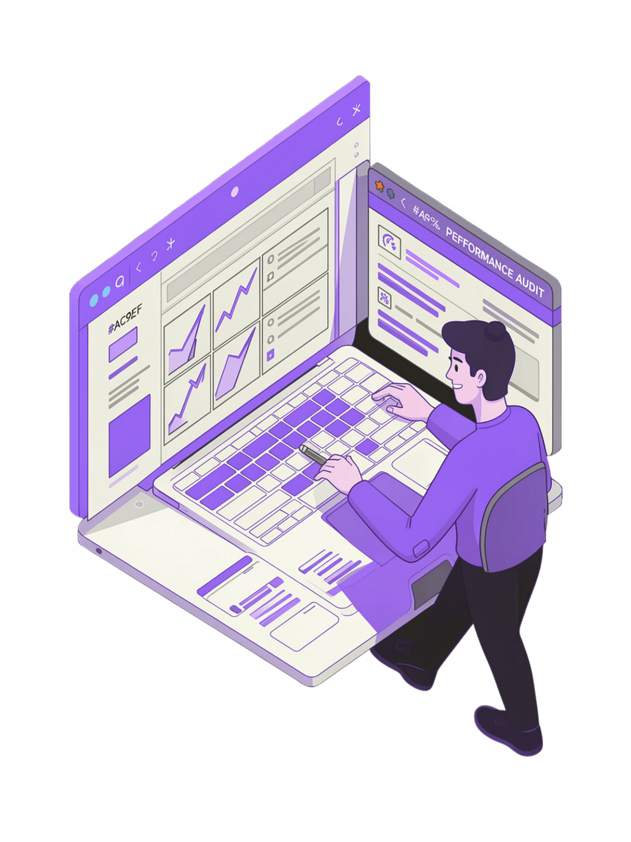
Week 4: Performance & Accessibility
⚡ Performance Optimization
♿ Accessibility Implementation
  Optimized CSS & removed redundancy
  Improved image loading & compression
  Reduced unnecessary JavaScript operations
  Lighthouse audits for performance scoring
  Semantic HTML & proper heading hierarchy
  Alt text for all images
  Form labels & keyboard navigation
  Visible focus states & ARIA attributes
  Skip-to-content & reduced-motion support

Slide 7

Week 5: Single Page Application Development
User
State
Application Views
Initiates interaction or navigation
Updates application state store
Core SPA Functionality
  Dynamic rendering without page reload
  Client-side routing with URL changes
  Browser Back/Forward navigation via History API
  State management & custom 404 handling
Router
DOM Rendering
Matches URL and selects route
Virtual DOM diff and patch
Home
Dashboard
Courses
Profile
About

Slide 8
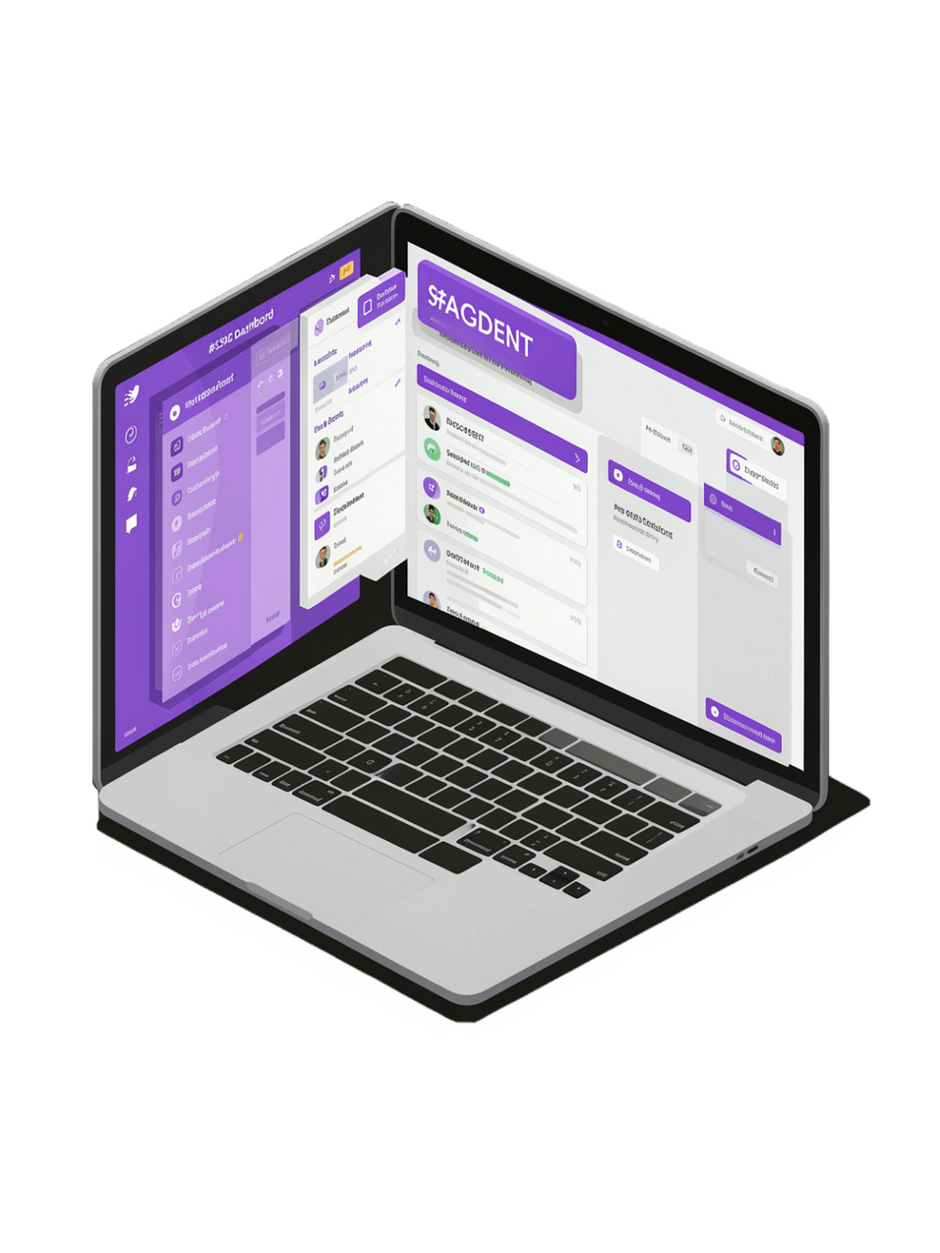
Final Project: Student Dashboard SPA
Client-Side Routing
Dynamic routing & History API integration
Course Filtering
Filter courses & manage profile data
Theme Switching
Light/Dark mode with Local Storage
Responsive Design
Fully responsive mobile navigation & layouts

Slide 9

Skills & Learning Outcomes
Technical Skills Gained
Challenges & Solutions
HTML5 & CSS3
Responsive Layouts
Dynamic Content
Flexbox, Grid, Media Queries
Solved with media queries & flexible units
Implemented DOM-based rendering
JavaScript
DOM manipulation & events
No-Reload Navigation
Code Organization
SPA Architecture
Used History API for routing
Structured HTML/CSS/JS for maintainability
Client-side routing & state
Accessibility
Performance optimization & a11y

Slide 10
Conclusion & Internship Journey
Week 1
1
Static Webpage
2
Week 2
Responsive Design
Week 3
3
JS Interactivity
4
Week 4
Performance & Accessibility
Week 5
5
SPA Development
  Gained practical frontend development experience across the full stack of web fundamentals
  Built responsive and interactive webpages from scratch using only Vanilla JS
  Mastered DOM manipulation, client-side routing, and SPA concepts
  Strengthened debugging, testing, and problem-solving skills
Thank You
Abhay Pratap Singh · B.Tech – Computer Science / Data Science
CS-23411052
IILM UNIVERSITY
GREATER NOIDA

